Slide 1
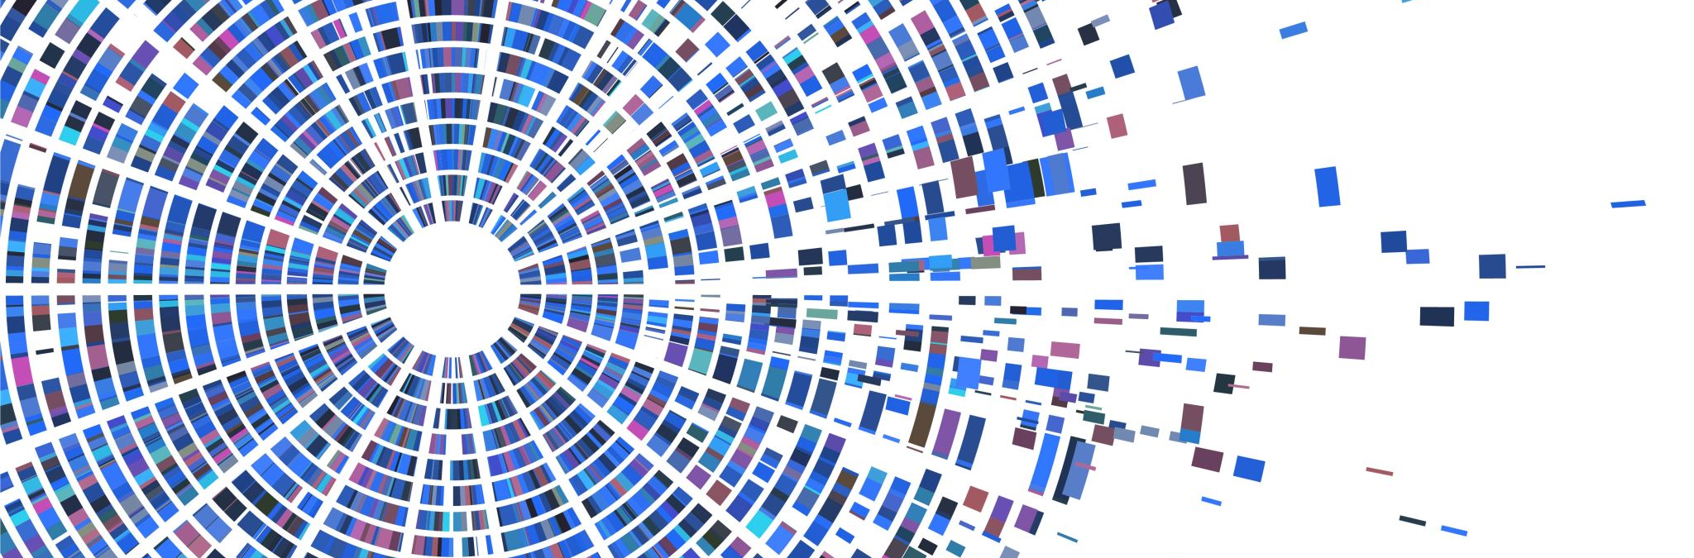
Data mining with Early stage diabetes risk prediction dataset
Group1
Nathan D
Shehnaz I
Thuy T

Slide 2
Table of content
Data Set Selection & Objective
Data Cleaning
Data Reduction
Data Visualization
Data Transformation
Algorithm and Evaluation Methods Selection
Q&A

Slide 3
Data SELECTION & OBJECTIVE
Data Set: Early Stage diabetes risk prediction
Problem: Classify diabetic vs non-diabetic patient at its early stage
Approximately 5 million of the 18 million people with diabetes in the U.S. do not know they have it. Early detection and treatment of diabetes is an important step toward keeping people with diabetes healthy. It can help to reduce the risk of serious complications such as premature heart disease and stroke, blindness, limb amputations, and kidney failure.
Objective: The purpose is to build a model to predict the classification of patients whether they are diabetic or not given all the symptoms they are experiencing.
Reference: https://aspe.hhs.gov/report/diabetes-national-plan-action/importance-early-diabetes-detection#:~:text=Early%20detection%20and%20treatment%20of,limb%20amputations%2C%20and%20kidney%20failure.
Notes:
https://aspe.hhs.gov/report/diabetes-national-plan-action/importance-early-diabetes-detection#:~:text=Early%20detection%20and%20treatment%20of,limb%20amputations%2C%20and%20kidney%20failure.

Slide 4
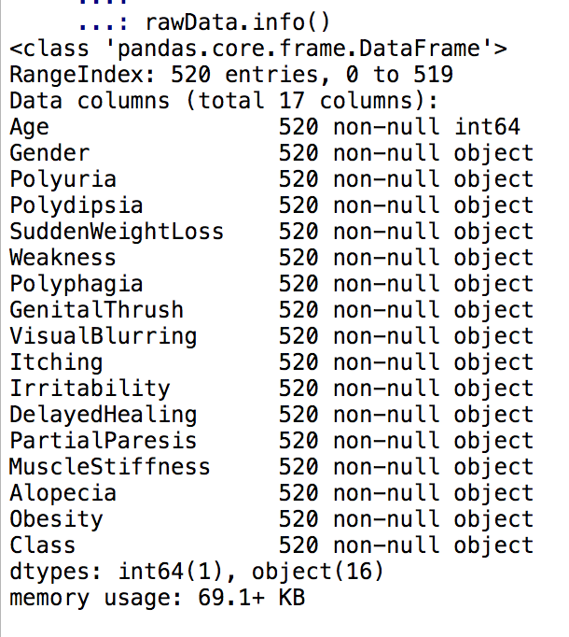
Data Cleaning
17 attributes: 16 categorical + 1 numeric attribute
520 patients
No missing values

Slide 5
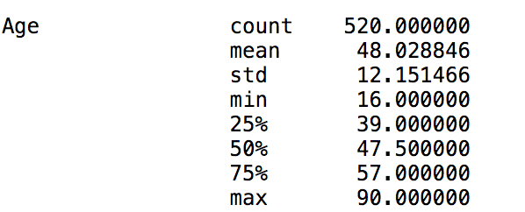
Data cleaning
Boxplot shows 2 outliers. However, when reviewing Min-Max range, Age is in acceptable range.

Slide 6
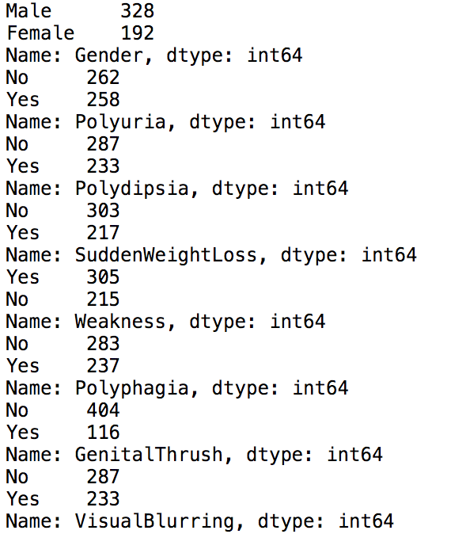
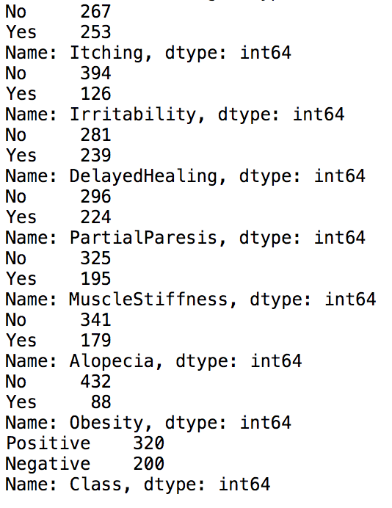
Data cleaning
All values are consistent. No noisy value. Either ’Yes’ or ‘No’, ‘Positive’, or ’Negative’, ‘Female’ or ‘Male’

Slide 7
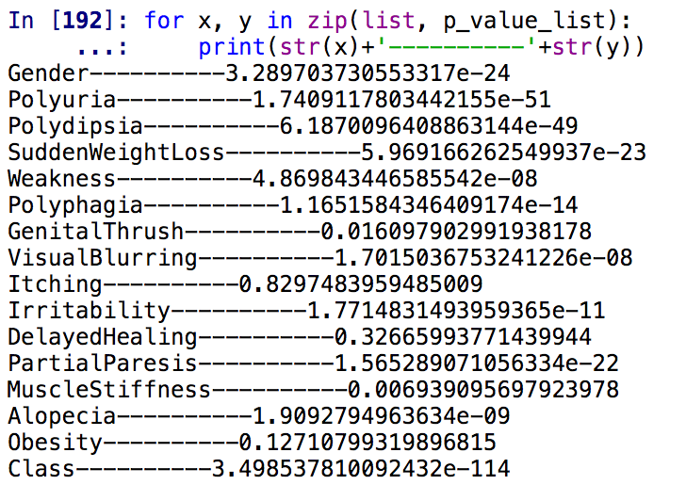
Data reduction
Chi-Square Test
Correlation
At 1% significant level, we can conclude that ﻿'Itching','DelayedHealing','Obesity','GenitalThrush’
are not statistically significant.

Slide 8
Explorative data analysis
Numeric Attribute: Age
Data Distribution: Normally Distributed (Skewness=0.33|Kurtosis=-0.19)
50% of the age values are in the range of 39 to 57
Being above 70 is more likely to be diagnosed with diabetes

Slide 9
Explorative data analysis
Categorical Attributes
Though number of males are more than female, female is more likely to get diabetes.
Diabetes cases are 120 cases more than Non-diabetes.
Diabetic patients are more likely to experience Polyruia, Weight Sudden Lost, Weakness and Polydipsia.
Notes:
Polyuria is a condition where the body urinates more than usual and passes excessive or abnormally large amounts of urine each time you urinate.
Polydipsia is the term given to excessive thirst.

Slide 10
Explorative data analysis
Categorical Attributes
Diabetic patients less likely to experience Alopecia than non-diabetic patient and more likely to experience Visual Blurring, Polyphagia, partial Paresis and Muscle Stiffness.
Notes:
Polyphagia, also known as hyperphagia, is the medical term for excessive or extreme hunger.
Partial Paresis involves the weakening of a muscle or group of muscles.

Slide 11
Data Transformation
Age – Data Discretization (<18 : ‘below 18’ | 18-45: ‘18-45’ |> 45: ‘above 45’)
Positive or Yes or Male -> 1
Negative or No or Female -> 0

Slide 12
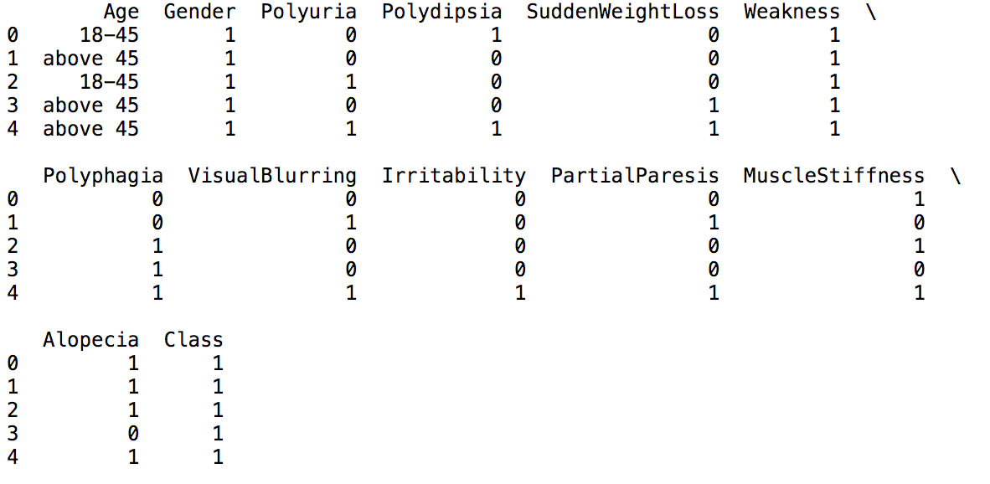
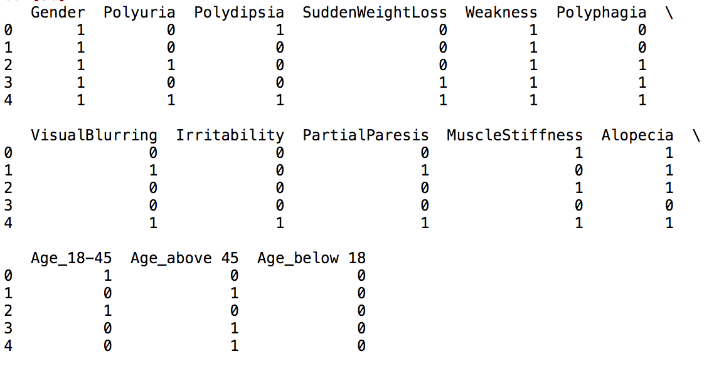
Data transformation
Machine learning algorithms cannot work with categorical data directly.
Categorical data must be converted to numbers.
Convert categorical variable into Indicator Variable.

Slide 13
MODel selection and Evaluation Methods
Evaluation and comparison
Error rate
ROC and AUC
Speed
Algorithm:
Naive Bayesian classier
Articial neural network
AdaBoost

Slide 14
Q&a

